Slide 1
Optical Communication and Networks(ECE4005)
UNDERWATER CODED COMMUNICATION USING INFRARED LIGHT
PROJECT BY:
Aman Shaji 17BEC1164
Illavenil .P 17BEC1046
Chanikya K 16BEC1046

Slide 2
UNDERWATER COMMUNICATION
Underwater wireless communications play an important role in marine activities such as environmental monitoring, underwater exploration, and scientific data collection. Underwater wireless communications still remain quite challenging, due to the unique and harsh conditions that characterize underwater channels.

Slide 3
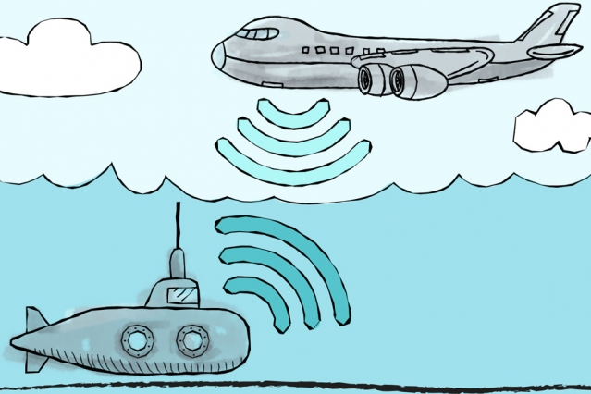
The necessity of Underwater Wireless Communication:
The wired underwater communication is not practicable in the following cases:
Temporary cases
Breaking of wires
Significant costs of deployment
Experiment over long distances

Slide 4
APPLICATIONS
The applications of the underwater wireless communication are as follows:
In the coming days, the applications could increase from myriad industries ranging from the offshore oil company to aquaculture and fishing industries.
It is also used in pollution control and climate recording.
It also has the application in the detection of the objects on the ocean floor.
Underwater wireless communication is also used in environmental monitoring and collecting of oceanographic information.
It has the application in marine archaeology, search and rescue machines and defense.
It is also used in seismic monitoring, pollution monitoring and ocean currents monitoring.
The underwater wireless communication is used in the equipment monitoring and control and also in the autonomous underwater vehicles (AUV).
It is also used in remotely operated vehicles (ROV).

Slide 5
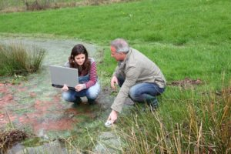
Environmental Monitoring
It monitors soil water and mineral content for irrigation, soil conditions for sports field monitoring, soli movement for landslides prediction.
It also monitors coalmine, glacier movement and earthquake monitoring.
It is also deployed for monitoring a golf course by monitoring soli salinity, water content and temperature

Slide 6
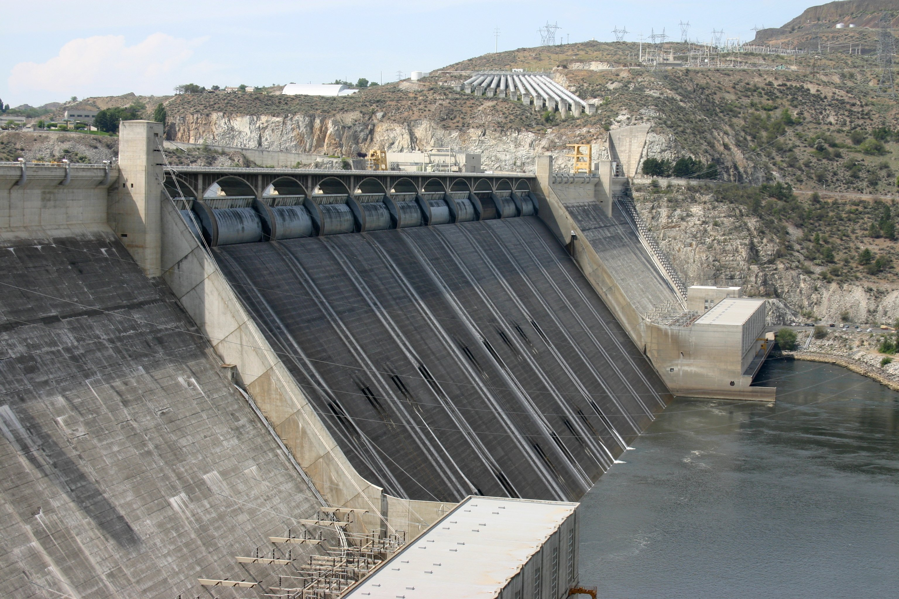
Infrastructure Monitoring
In infrastructure monitoring the sensors monitors the infrastructure of the pipe, wiring and underground components like dams and the minefields.
In this application, the sensors also deploy for the location determination of objects, which includes driver alert, autonomous fertilizer unit, and in case of building collapse it locate people.

Slide 7
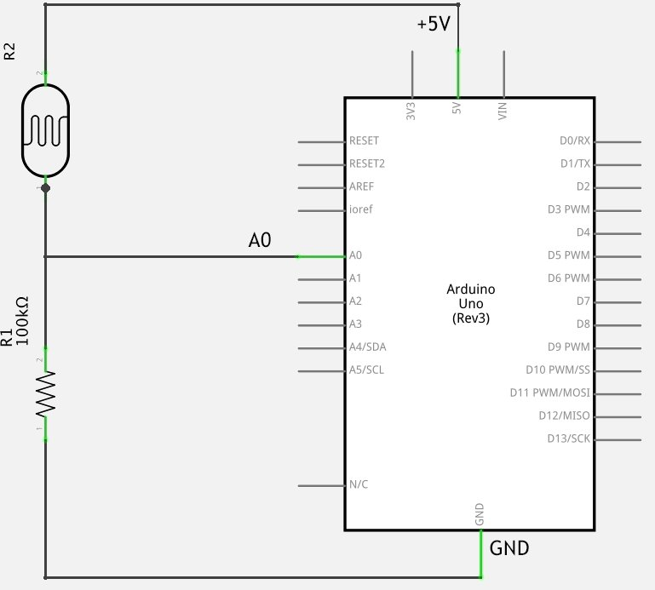
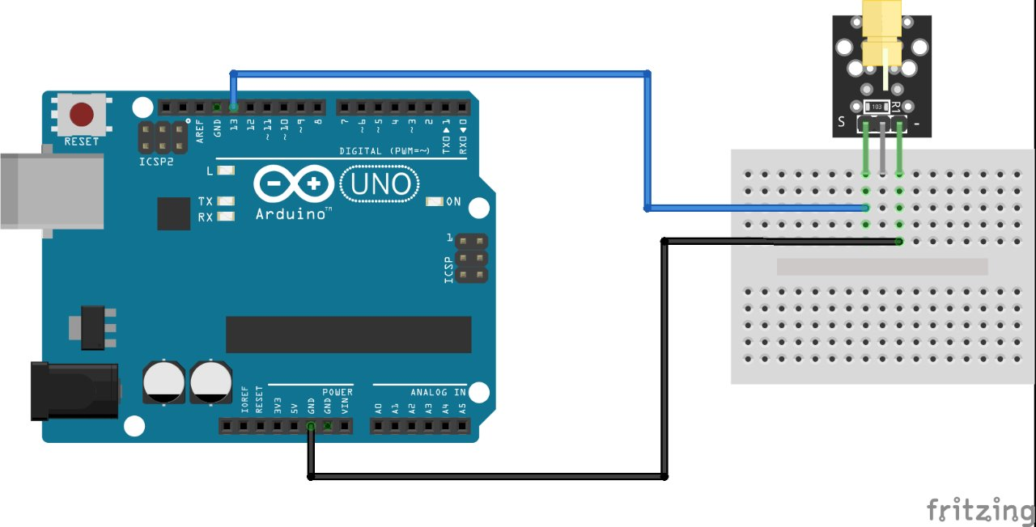
CIRCUIT DIAGRAM

Slide 8
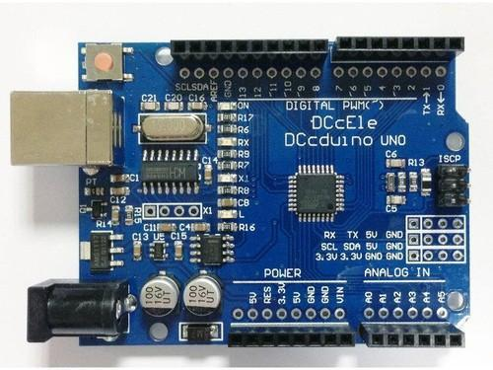
HARDWARE REQUIRED
ARDUINO UNOS:
The Arduino Uno is an open-source microcontroller board based on the Microchip ATmega328P microcontroller and developed by Arduino.cc. The board is equipped with sets of digital and analog input/output pins that may be interfaced to various expansion boards and other circuits.

Slide 9
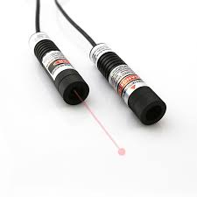
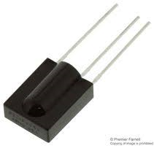
HARDWARE REQUIRED
INFRARED LASER
Infrared light to send the message which can be modulated and coded
INFRARED SENSOR
The infrared light is received by this sensor and the values are send for decoding

Slide 10
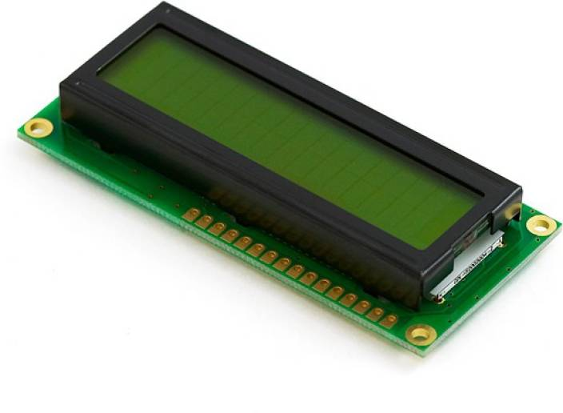
HARDWARE REQUIRED
LCD DISPLAYS:
A liquid-crystal display is a flat-panel display or other electronically modulated optical device that uses the light-modulating properties of liquid crystals combined with polarizers. Liquid crystals do not emit light directly, instead using a backlight or reflector to produce images in color or monochrome

Slide 11

SOFTWARE REQUIRED
ARDUINO IDE:
The Arduino Integrated Development Environment is a cross-platform application that is written in functions from C and C++. It is used to write and upload programs to Arduino compatible boards, but also, with the help of 3rd party cores, other vendor development boards

Slide 12
working
1) We take an image with text as input.
2) We process the image and convert into readable text format.
3) This text is transferred from source to destination in the form of Morse code with the help of a laser.
4) The light falls on to the receiver where it gets decoded and the message is displayed.

Slide 13
Image to text format
The process of converting an image to an editable document is divided into several steps. Every step is a set of related algorithms that do a piece of the OCR job. The general steps in the OCR process are as follows:
1. Loading an image as bitmap from a given source. The source can be a file or a pointer to a memory block. Moreover, a good OCR system must understand a lot of image formats: BMP, TIFF, JPEG, PNG, and so on. It must also support PDF files, because many documents are stored as images in the PDF format, and the only way to extract text from such files is to perform OCR.
2. Detecting the most important image features, such as resolution and inversion. Many OCR algorithms expect a predefined range of font sizes and foreground/background colours, so the image must be rescaled and inverted before processing if necessary.
3. Many OCR algorithms can handle bi-tonal images only, so colour or grayscale images must be converted to bi-tonal. The process is called "binarization." This step is very important, because incorrect binarization will cause a lot of problems.

Slide 14

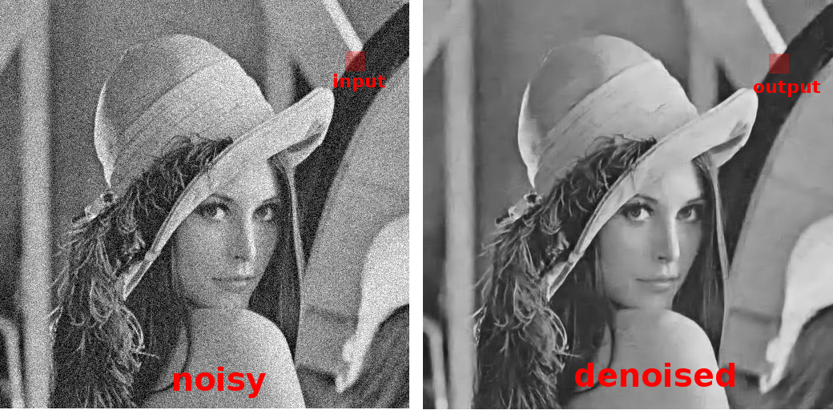
OCR
The general steps in the OCR process are as follows:
•Loading an image as bitmap from a given source. The source can be a file or a pointer to a memory block. Moreover, a good OCR system must understand a lot of image formats: BMP, TIFF, JPEG, PNG, and so on. It must also support PDF files, because many documents are stored as images in the PDF format, and the only way to extract text from such files is to perform OCR.

Slide 15

OCR
•Detecting the most important image features, such as resolution and inversion. Many OCR algorithms expect a predefined range of font sizes and foreground/background colours, so the image must be rescaled and inverted before processing if necessary.

Slide 16

OCR
•Many OCR algorithms can handle bi-tonal images only, so colour or grayscale images must be converted to bi-tonal. The process is called "binarization." This step is very important, because incorrect binarization will cause a lot of problems.

Slide 17
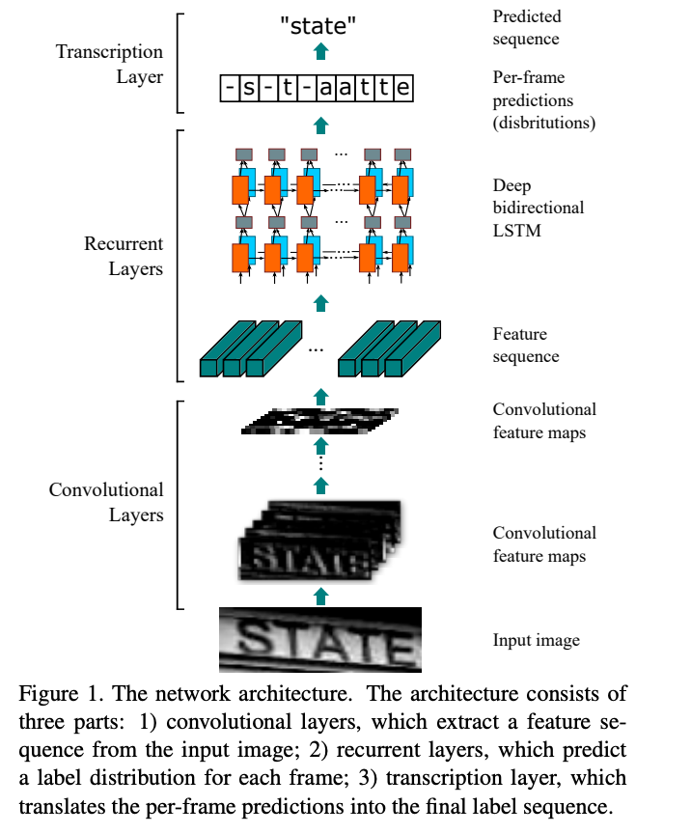
OCR

Slide 18
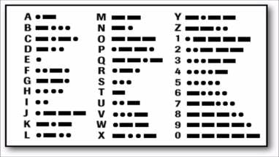
MORSE CODE
Morse code implementation in optical communication :
We used two Arduino boards to build a transmitter and a receiver.
On the transmitter board, we connected a Laser diode from Keyes. Since it is easily available and a cheap device. For the distance we are working, 3v input was more than sufficient, however with 5v, we can see the laser reaching at least 200m.

Slide 19
MORSE CODE
My transmitter is connected to a computer with Serial interface (over USB). It reads for any data on Serial port, character by character and finds the equivalent Morse code for the character and generate ‘dot’ and ‘dash’ light stream.
We created a 50ms pulse, where each ‘dot’ is a 50ms light beam and a ‘dash’ being 150ms light beam. Each ‘dot’ and ‘dash’ are separated by a 50ms silence. Each character is followed by another 100ms of silence.

Slide 20
TIMELINE
review1
TITLE CONFORMATION
GATHERING COMPONENTS AND SOFTWARE REQUIRED
review2
CIRCUIT SIMULATION AND TESTING IT
CODING AND SOFTWARE IMPLEMENTAION
review3
TESTING AND DEBUGGING
FINAL IMPLEMETAION AND OUTPUT

Slide 21
WORK COMPLETED
OCR:
IMAGE PROCESSING
REMOVING NOISE
IMAGE ENHANCING
TEXT RETRIEVAL
LIGHT TRANSMITTER:
Successfully created code to transmit efficiently
Code for converting letters into morse code format
Transmission part successful
Reciever succesful in getting transmitted data
Output displayed

Slide 22
WORK COMPLETED
FINAL ADJUSTEMENTS:
Integrating the OCR and transmitter
Debugging the space character in transmitter side
Improved power of receiver and transmitter

Slide 23
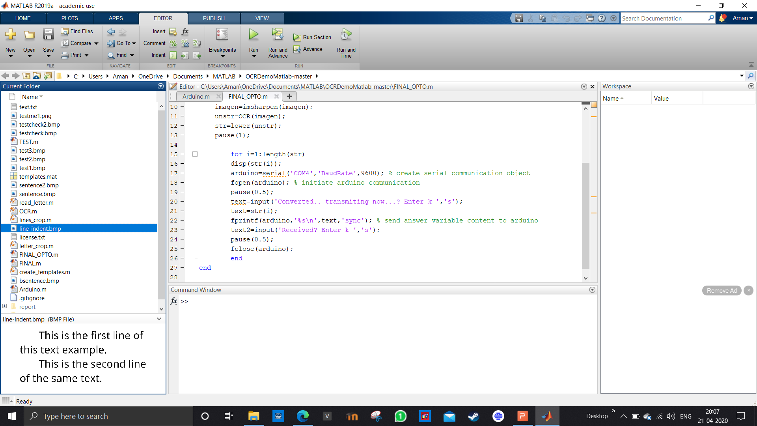
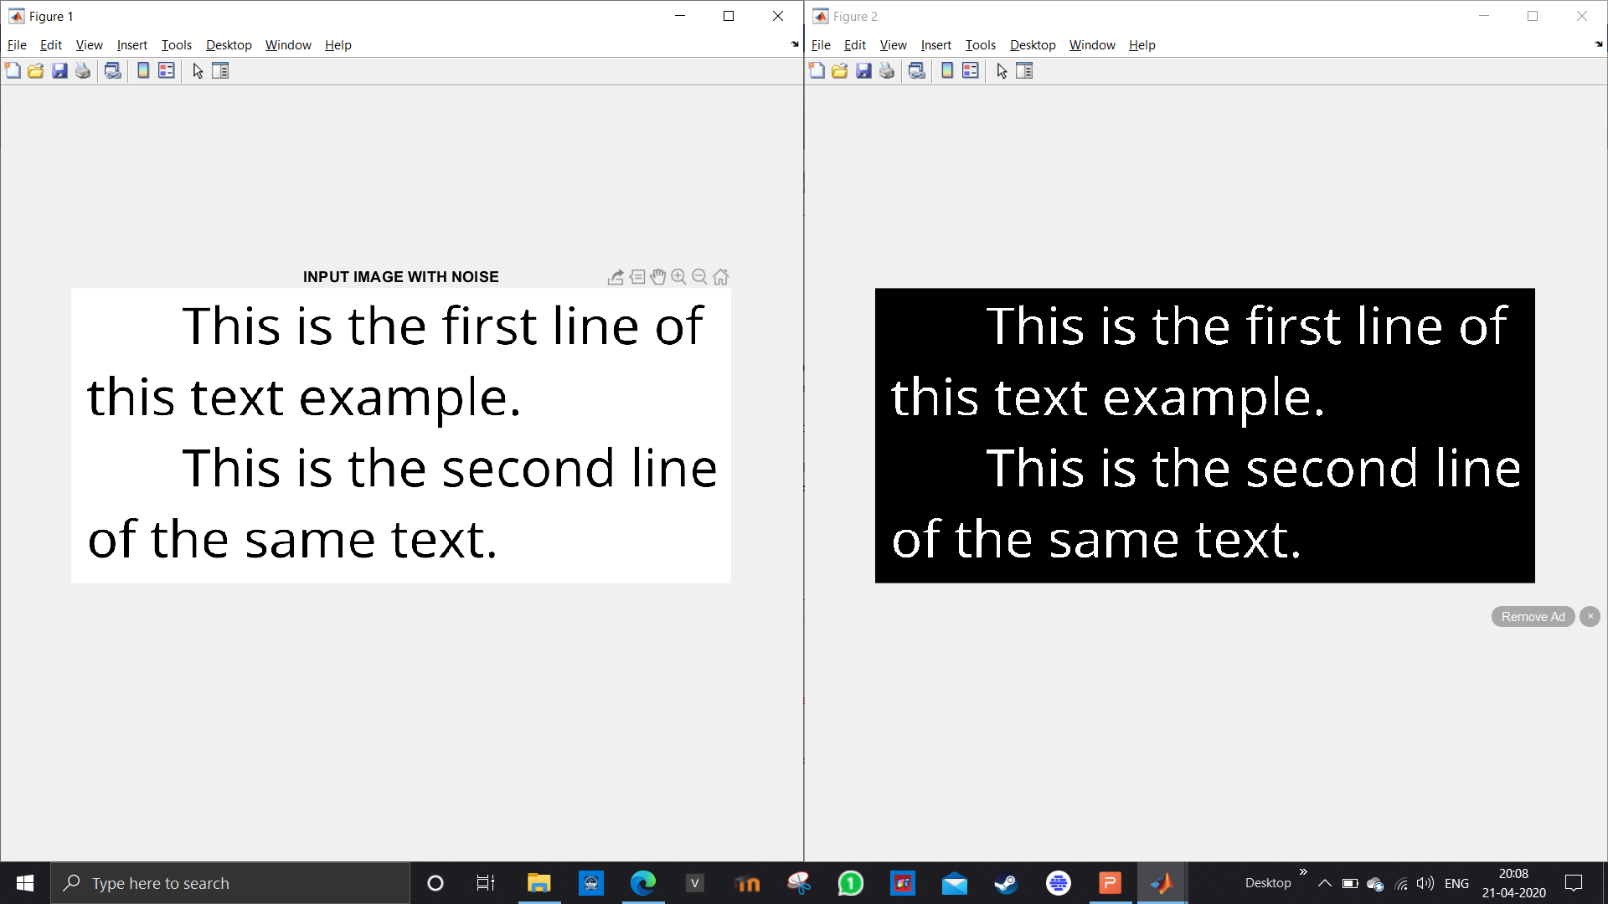
OCR in matlab

Slide 24
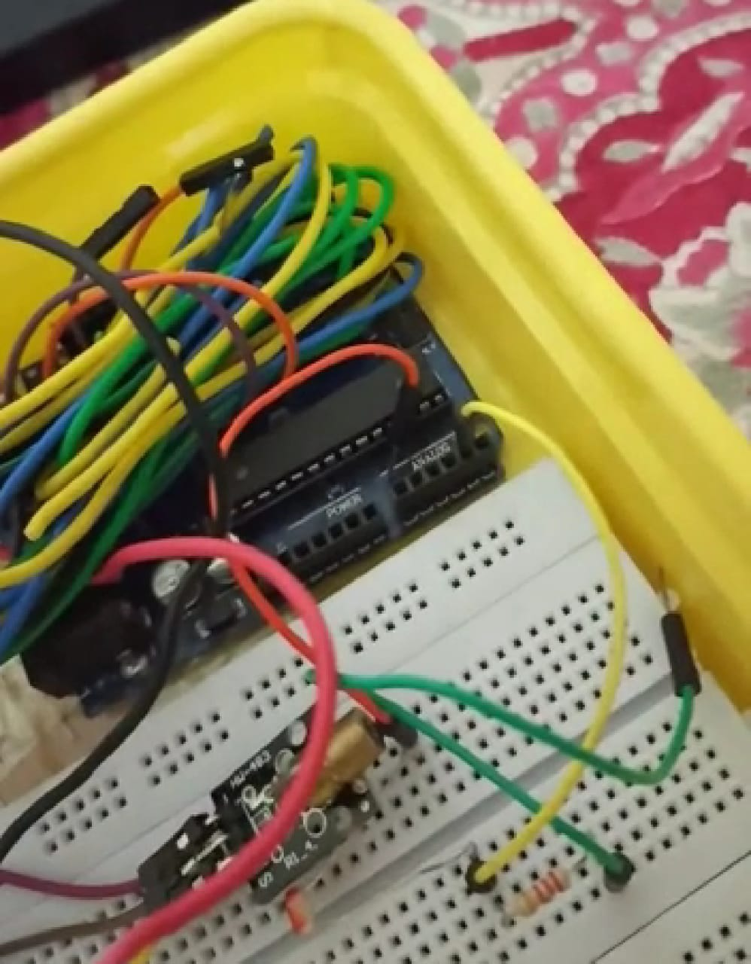
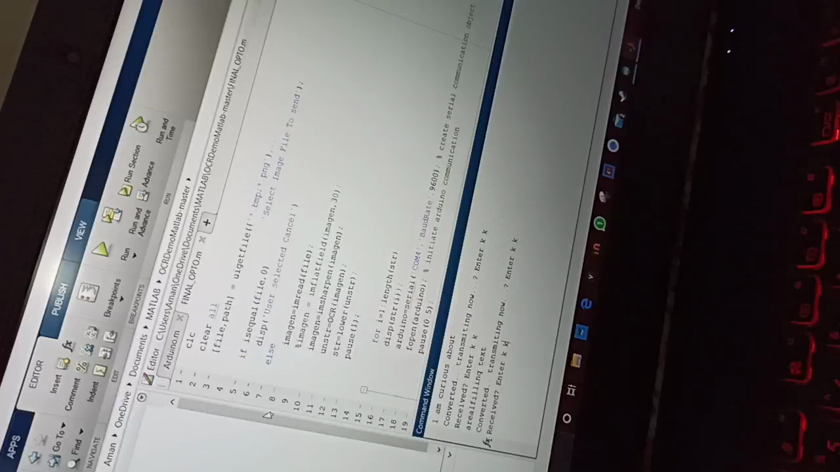
TRANSMITTER/RECEIVER SECTION
WORKING VIDEO

Slide 25
RESULTS
The efficiency of current laser limits distancing of transmitter and reciever
More powering required to get better results in well litted rooms
The accuracy is variable in some cases
Application underwater has to be explored

Slide 26
REFERENCES
https://en.wikipedia.org/wiki/Morse_code
https://en.wikipedia.org/wiki/Optical_character_recognition
https://in.mathworks.com/help/vision/examples/recognize-text-using-optical-character-recognition-ocr.html
https://in.mathworks.com/help/vision/optical-character-recognition-ocr.html
https://www.instructables.com/id/DIY-Li-Fi-Using-Arduino-Uno/
http://blog.makezine.com/2008/08/13/laser-modem-with-an-ardui/
https://www.instructables.com/id/Li-Fi-Build-Your-Own-Safe-Wireless-Communication-N/

Slide 27


